Slide 1



Edge Map Extraction of High Resolution Facial Images.

Slide 2


01
Problem Statement
Agenda
02
Literature Survey
Topics Covered
03
Algorithm
04
Performance and Evaluation
05
Conclusion

Slide 3


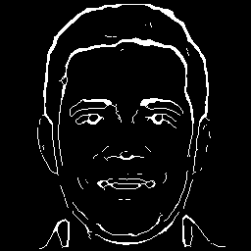
Problem Statement
The research's goal is to introduce an innovative algorithm designed to identify and extract edges within high-resolution facial images. The primary aim is to strike a balance between detecting and extracting both intricate and prominent features from these images.

Slide 4

Algorithm
Step - 1 : Smoothing
Smoothing is a significant step for facial images due to their abundance of intricate details like hair strands and dark patches.
Fine characteristics can obscure or complicate boundaries in the edge maps, affecting their accuracy and clarity.
Smoothing techniques are employed to mitigate the impact of these extraneous details, allowing for effective extraction of essential information.
The Gaussian kernel size, determined by the standard deviation (σ), is crucial.
Higher σ values lead to increased picture blurring, effectively reducing noise in the edge maps.
However, larger σ values also result in the exclusion of finer edges, highlighting only the larger ones.

Slide 5
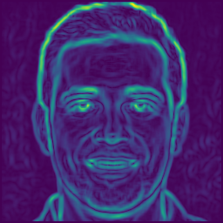
Algorithm
Step - 2 : Directional Gradients
Compute the directional gradient of the smoothed image using horizontal and vertical filters. This gradient reveals the rate of intensity change in specific directions, aiding edge detection.
The horizontal filter detects changes along the image's horizontal axis, while the vertical filter does the same vertically. These combined filters yield the directional gradient image, indicating intensity change speed in each direction.
Calculate the gradient magnitude, a non-directional measurement of the gradient. This scalar value indicates edge or boundary strength at a pixel location.
The gradient vector's magnitude lacks direction information; it signifies overall edge intensity rather than orientation. This is useful for identifying local maxima, which correspond to true edge points in the image.

Slide 6
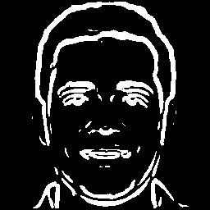
Algorithm
Step - 3 : Weak Edge Detection
Detect weak edges along curves by employing a lower threshold, determined from the mean gradient magnitude.
Weak edges typically exhibit lower gradient magnitude, yet possess local maxima in horizontal and vertical directions.
Implement a thresholding process: Identify a point as a weak edge point when it fulfills two criteria:
Displays local maxima in both horizontal and vertical directions.
The gradient magnitude at that point surpasses the lower threshold value.

Slide 7
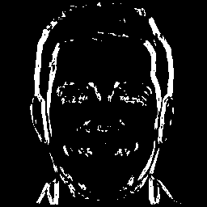
Algorithm
Step - 4 : Strong Edge Detection
Strong edge identification involves calculating cumulative gradient change between directions, specifically horizontal and vertical. This method differentiates main strong edges from small, insignificant ones.
Cumulative gradient change quantifies gradient value alteration over a defined distance in a specific direction, a key measure for detecting strong edges.
The method targets areas where gradient values significantly shift in one direction while remaining relatively steady in the other. These areas represent strong edges with swift intensity changes along a certain direction.
Verify that the gradient magnitude at a point surpasses a predefined upper threshold (threshold: 0.90).
Confirm the presence of a local maximum in at least one direction.
Compare the overall gradient change along the edge direction to that in the opposite direction. Strong edges exhibit greater change along the edge direction.

Slide 8
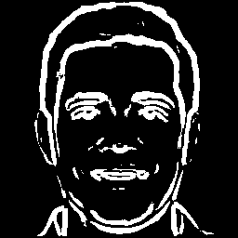
Algorithm
Step - 5 : Merging
To create an output image displaying both weak and strong edges, the images from the weak and strong edge detection processes are merged.
Merging is achieved through an element-wise OR operation applied to corresponding pixels in the two binary images.
The OR operator produces a pixel value of 1 if at least one input pixel is 1; otherwise, it yields 0.
This process results in an output image where pixels are set to 1 if an edge was detected in either the weak or strong edge detection image, and to 0 if not.
Weak Edge Map
Edge Map representing both weak and strong edges
Strong Edge Map

Slide 9
Algorithm
Step - 6 : Thinning
The results obtained in the previous section undergo two iterations of the Zhang-Suen thinning process.
The Zhang-Suen thinning algorithm is a widely used method for skeletonization, which involves reducing a binary image to its essential skeletal structure.
This technique operates by iteratively removing pixels located at the borders of picture objects.
The process continues until the objects transform into lines that maintain a width of only one pixel.

Slide 10

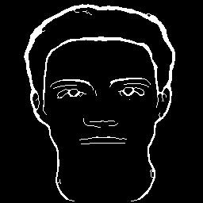

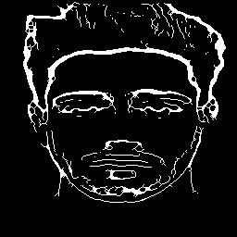
Performance & Evaluation
Performance on different database
The proposed algorithm successfully extracts edges from both high-resolution and low-resolution images.
The adaptability is demonstrated by consistent edge map generation across diverse datasets.
Low-resolution images yield near-perfect results, despite inherent detail limitations.
High-resolution images from different datasets also show effective edge capture.
Variations in edge map detail are observed based on input image resolution.
Results on running the algorithm on low resolution images from different dataset
Results on running the algorithm on high resolution images from different dataset

Slide 11
Performance & Evaluation
Comparative Analysis
For the comparative analysis, 2 existing algorithms have been considered
CANNY EDGE DETECTION
HED Method
Canny Edge Detection:
Struggles with accurate facial outlines.
Produces fragmented and disconnected edges.
May result in incomplete or distorted facial structures.
HED (Holistically-Nested Edge Detection):
Better at highlighting facial outlines than Canny.
Captures overall facial shape and contour with improved accuracy.
Falls short in capturing intricate low-level details. May lack precision and clarity for comprehensive representation.

Slide 12
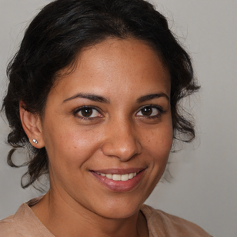

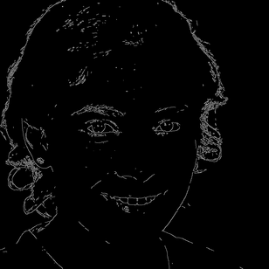
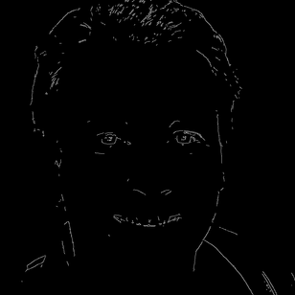
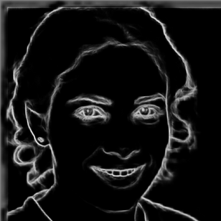
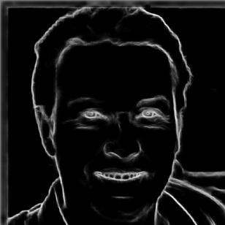
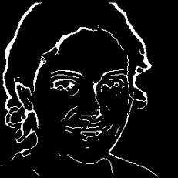
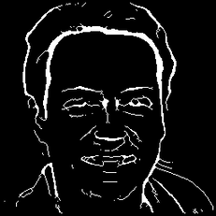
Performance & Evaluation
Original
Comparative Analysis
Proposed Method:
Skillfully captures both low-level and high-level facial details.
Strikes a balance between the two, avoiding excessive low-level detail emphasis.
Offers a comprehensive representation with high resolution.
Results in a visually pleasing depiction of the face. Considers both intricate and broader facial elements, providing an improved and faithful representation of facial features.
Canny
HED
Proposed
Algorithm

Slide 13
Performance & Evaluation
Subjective Analysis
Subjective Analysis: 39 volunteers evaluated the proposed high-resolution facial edge map extraction algorithm.
Positive Feedback: Participants praised the accuracy and quality of extracted edge maps but noted occasional inaccuracies in preserving fine facial details.
Improvement Suggestions: Recommendations included addressing illumination variations and refining fine-level detail extraction.
Future Guidance: Participant feedback highlights the need for ongoing research to enhance algorithm adaptability and precision in capturing facial contours and intricate details.

Slide 14
Conclusion
Primary Objective: To generate highly detailed edge maps for high-resolution facial images by overcoming limitations of existing edge detection methods.
Comparative Analysis: The proposed methodology outperforms Canny and HED techniques, effectively highlighting subtle edges while preserving low-level details.
Subjective Validation: Subjective analysis confirms that the edge maps are both persuasive and visually pleasing to human observers.
Future Research: Ongoing work includes extending the methodology to handle varying illuminations and lateral viewpoints in facial image processing.

Slide 15
Thank You
Corresponding Authors : Harshit Timmanagoudar
Gandra Sai Krishna
Anirudh Koti
Harsh Jolad
Contributing Author : Preethi P
Affiliation : Department of Computer Science, PES University

